Slide 1
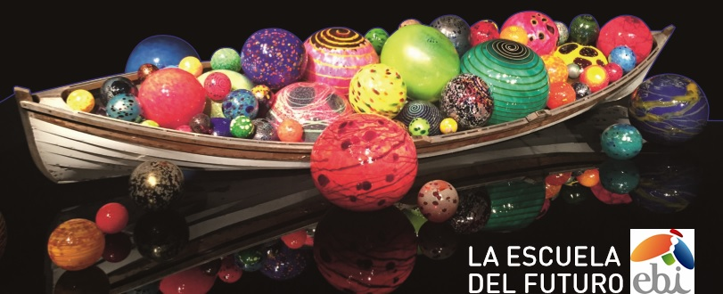



CAPP International Conference
The Family facing Job Uncertainties and the Digital Cultural Revolution

Slide 2

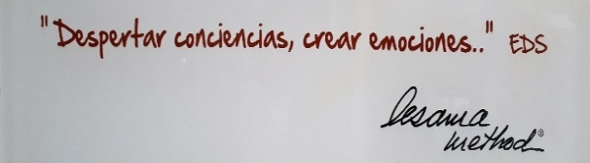
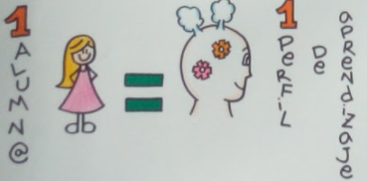
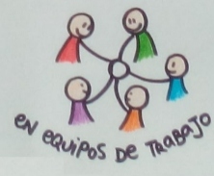
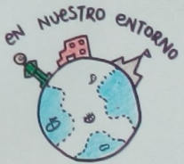
Background information
Santa María la Blanca school, or CSMB, is a Catholic educational center in which the levels of Infants, Primary, Secondary and Baccalaureate are taught with 2,400 students from 0 to 18 years
Founded in 2008, what started as an innovative center project has become a national and international benchmark and case study by the OECD due to the success of our EBI education system that has been implemented in schools in Spain, US and Dominican Republic.
Mission and Vision
Our mission is to be a reference institution that offers society an educational proposal that aims at the comprehensive education of the student and the pursuit of academic excellence.
The vision of Santa María la Blanca is based on two fundamental criteria:
All educational action must be understood and develop to maximize each student´s learning profile. 1 STUDENT = 1 LEARNING PROFILE
All educational action must facilitate the building of meaningful relationships. ONE ON ONE; WORKING AS A TEAM; IN OUR SURROUNDINGS
“AWAKENING CONSCIOUSNESS
CREATING EMOTIONS”
CAPP INTERNATIONAL CONFERENCE – THE VATICAN – MAY 2018

Slide 3
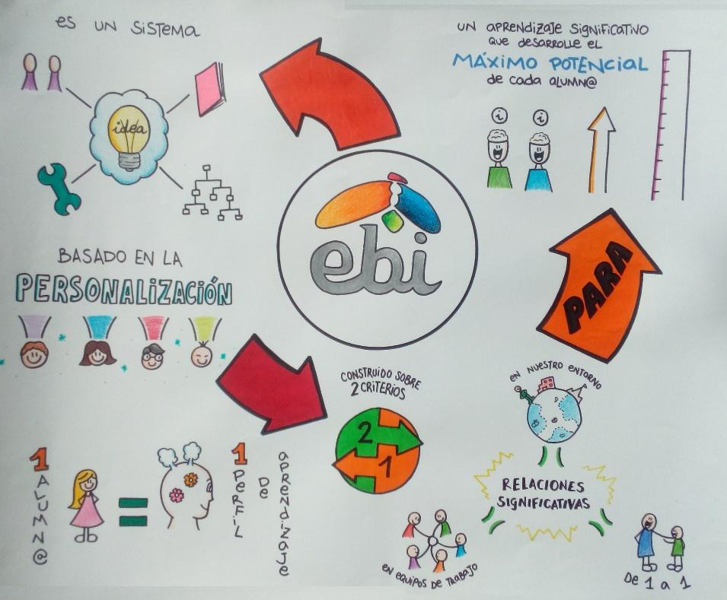
EBI System
The EBI System seeks to guarantee meaningful learning, the development of the key competences of the system (competence for autonomous learning, digital competence, communicative competence and personal and social competence) and the development of the maximum potential of each student.
This personalization system is based on FOUR PRINCIPLES:
Planning centered in the student
Teacher identity construction
Building a learning community
Transformation to a curriculum based on understanting
FOR CUSTOMIZATION
CAPP INTERNATIONAL CONFERENCE – THE VATICAN – MAY 2018

Slide 4
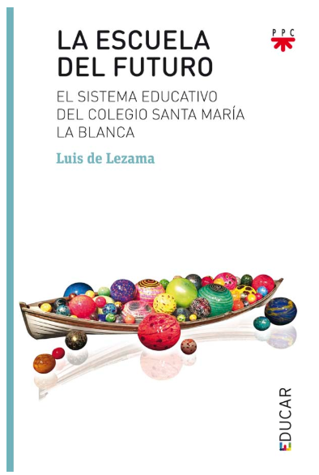
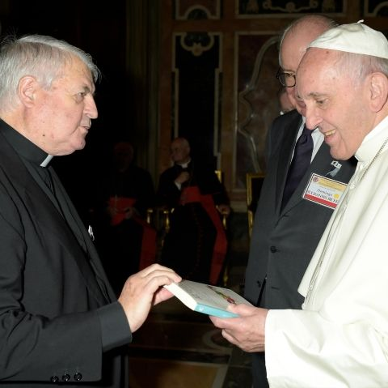
Relevant facts
Father Lezama handing its book “The School of the Future. The educational system of St. María la Blanca School” to Holy Father Pope Francisco.
It has two prologues written by Dr. Andreas Schleicher, Director for Education and Skills at OECD, and Dr. Luis Ricardo Fraga, Notre Dame University and former educational advisor of ex US President Mr. Barack Obama.
It´s on fifth edition and it will be translated into English by Central Washington University (http://www.cwu.edu/) and its School of Education.
CAPP INTERNATIONAL CONFERENCE – THE VATICAN – MAY 2018

Slide 5
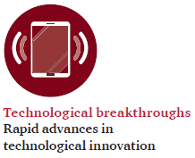
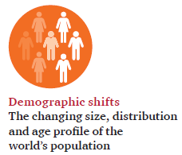
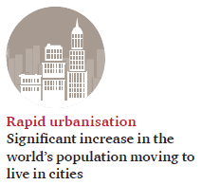

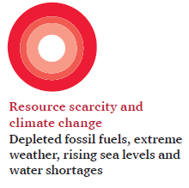
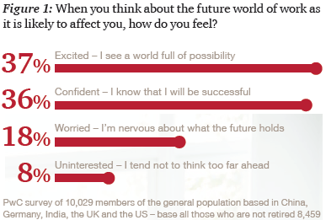
The future of participation in education
CAPP INTERNATIONAL CONFERENCE – THE VATICAN – MAY 2018

Slide 6
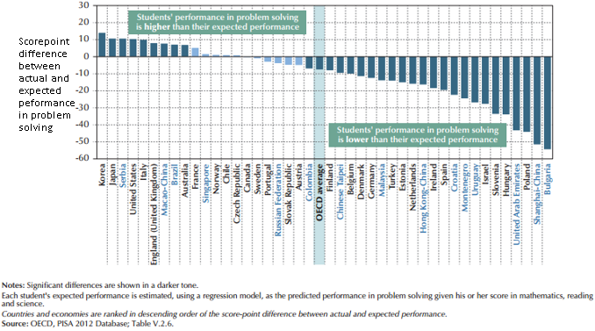
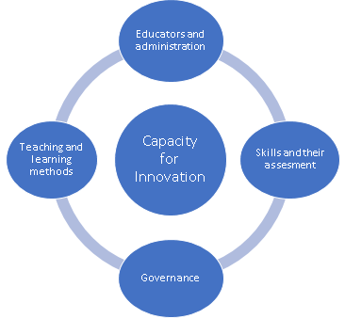
An education system that boosts innovation skillsets for young europeans
TEACHING AND LEARNING METHODS.
THE EDUCATORS (INCLUDING PARENTS AND FUTURE EMPLOYERS) AND ADMINISTRATION.
SKILLS REQUIERED, KPIs AND THE ASSESMENT METHODS.
THE GOVERNANCE.
CAPP INTERNATIONAL CONFERENTE – THE VATICAN – MAY 2018

Slide 7

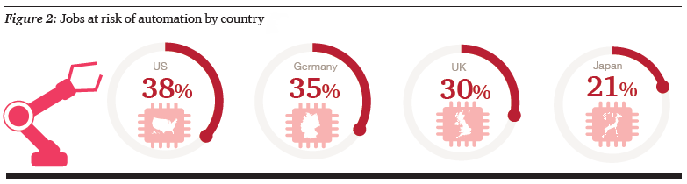
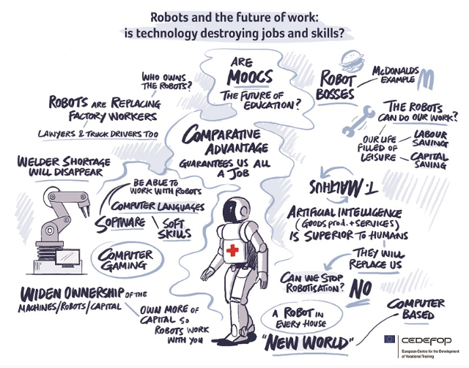
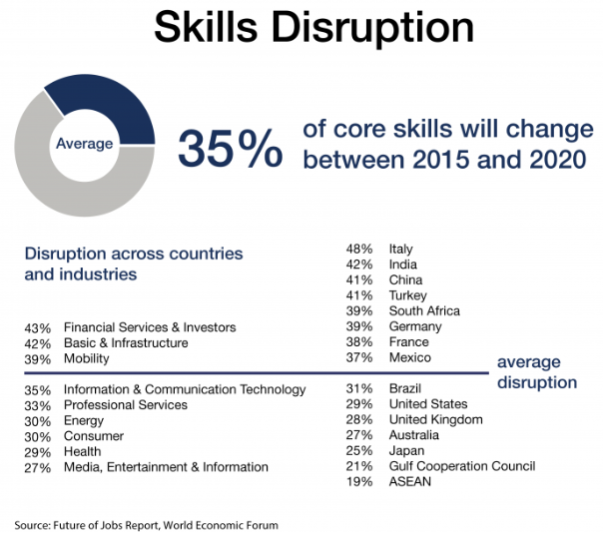
What do we tell our families and students at St. María la Blanca?
As human beings we have to be prepared to face the future, have the capacity to adapt and respond to change.
Believing that all students can learn and achieve at high levels.
The secret for a bright future seems to lie in flexibility and in the ability to reinvent yourself
CAPP INTERNATIONAL CONFERENCE – THE VATICAN – MAY 2018

Slide 8
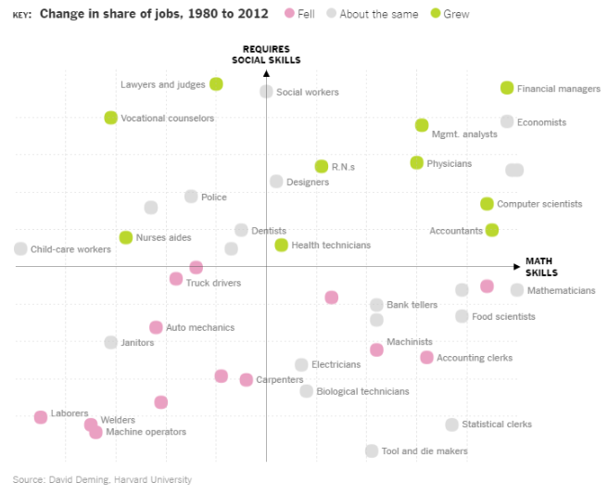
What to do from now on?
EDUCATING FOR AN UNCERTAIN WORLD.
DEVELOPING KNOWLEDGE, SKILLS AND CHARACTER FOR AN AGE OF ACCELERATIONS.
LEARNING TO BE CRITICAL CONSUMERS OF INFORMATION.
COLLABORATING WITH OTHERS.
“We believe that teacher support and home environment support could be the most effective ways to help students succeed”.
Management team of Santa María la Blanca School
CAPP INTERNATIONAL CONFERENCE – THE VATICAN – MAY 2018

Slide 9
Families and digital transformation
What is our definition of innovation?
All change based on knowledge that generates value.
The three aspects must be paced so that innovation flourishes
CAPP INTERNATIONAL CONFERENCE – THE VATICAN – MAY 2018

Slide 10


Appreciation and contact details
Name: Iñaki Echeveste
Organization: Foundation Iruaritz Lezama
Email: iecheveste@fundacionlezama.es
Website: http://proyectoebi.es/
PROYECTO EBI
CAPP INTERNATIONAL CONFERENCE – THE VATICAN – MAY 2018

Slide 11
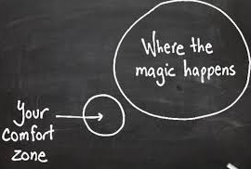


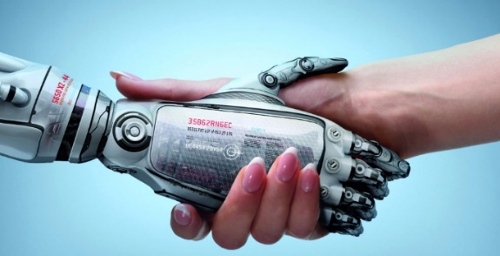

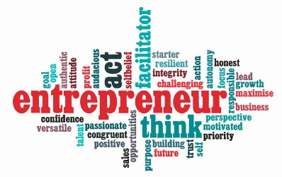
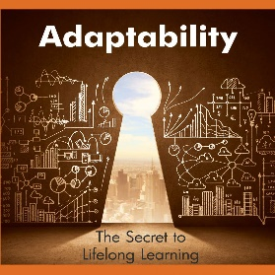
What are our messages for leaders?
ACT NOW
MAKE A BIGGER STEP
NO REGRETS AND BETS
OWN THE AUTOMATION DEBATE
PEOPLE NOT JOBS
ENTREPRENEURIAL ATTITUDE
ADAPTABILITY IS THE KEY TO FUTURE
CAPP INTERNATIONAL CONFERENCE – THE VATICAN – MAY 2018

