Slide 1

L’importanza di una corretta e condivisa misurazione per conoscere e governare l’impatto economico e sociale della transizione
Prof.ssa Loriana Pelizzon

Slide 2
ESG Reporting
Non-financial disclosure
The concept of materiality
The challenge of reporting data across multiple frameworks

Slide 3
ESG Reporting
To organize and render consistent the diversity of non-financial information potentially available, a number of sustainability accounting frameworks have evolved over the last quarter-century.
CDP: Climate Disclosure Project
CDSB: Climate Disclosure Standards Board
GRI: Global Reporting Initiative
IIRC: International Integrated Reporting Council
SASB: Sustainability Accounting Standards Board
TCFD: Task force on Climate-related Financial Disclosure
ISFR: International Sustainability Standards Board

Slide 4





ESG Reporting Frameworks
Year of lanch 1997
Year of lanch 2010
Year of lanch 2011
Year of lanch 2017
Year of lanch 2000
https://www.globalreporting.org/
https://integratedreporting.org/
https://www.sasb.org/
https://www.fsb-tcfd.org/
https://www.cdp.net/en
PURPOSE: Help organizations report on economic, environmental & social impacts considering a wide range of investments
PURPOSE: Establish Guiding Principles and Content Elements allowing companies to produce “integrated reports”
PURPOSE: Facilitate disclosure of material sustainability information in SEC filings
PURPOSE: Encourge firms to align climate-related risk disclosures with investors’ needs
PURPOSE: Capture environmental performance data related to GHG emissions, water, forests and supply chain
E
S
G
E
S
G
E
S
G
E
S
G
E
S
G
Corporate sustainability reports
AUDIENCE: Broad set of stakeholders
Stand-alone integrating report
AUDIENCE: investors
SEC Form 10-K, 20-F filings and ESG reports
AUDIENCE: investors
Annual financial filings
AUDIENCE: investors, lenders, insurers
CDP’s online reporting platform
AUDIENCE: investors, buyers, other stakeholders
→ Most widely adopted standard for sustainability reporting
→ Principle-based and difficult to apply
→ Based on financial materiality
→ Group of finance ministries and
central banks from G20 countries
→ Longest running
time series of corporate climate change disclosures in existence
Frameworks for Non-Financial Reporting
Climate Change-Related Frameworks

Slide 5

Publicly Available ESG Ratings
S&P
Refinitiv
MSCI
Sustainalytics

Slide 6
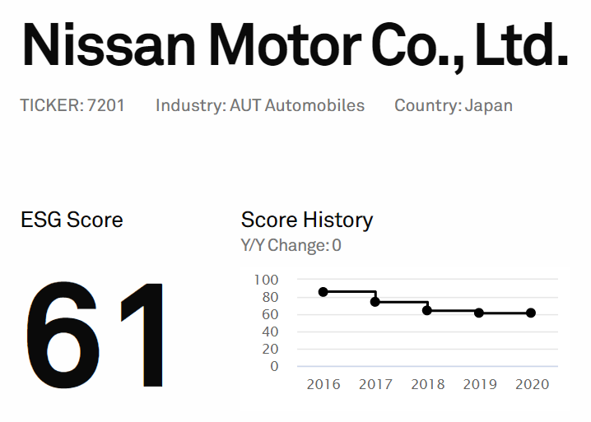
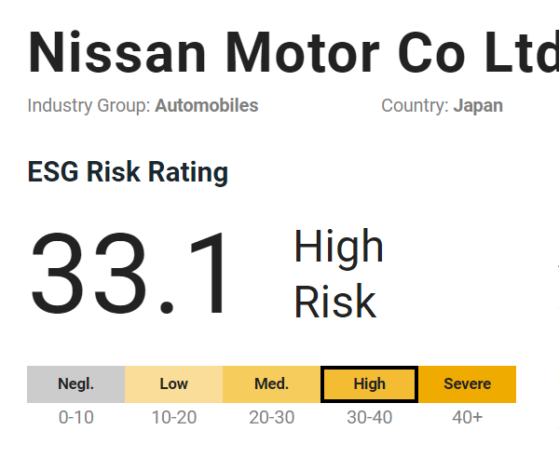
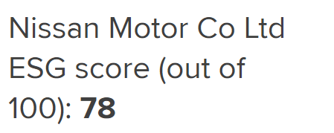
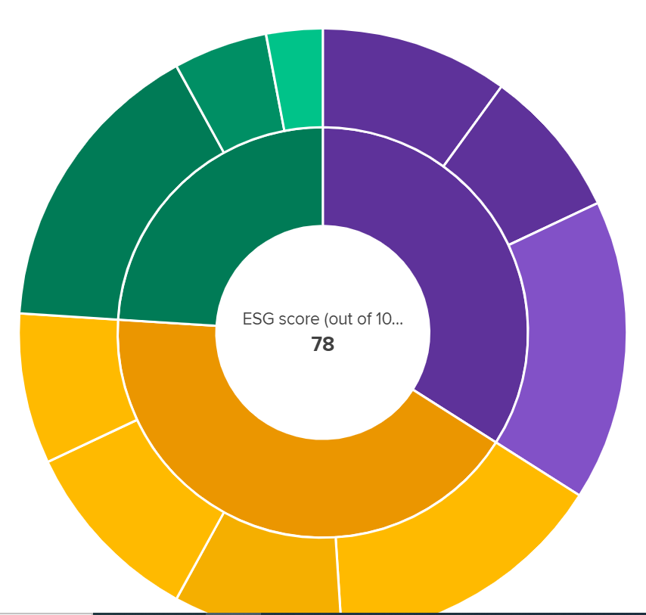
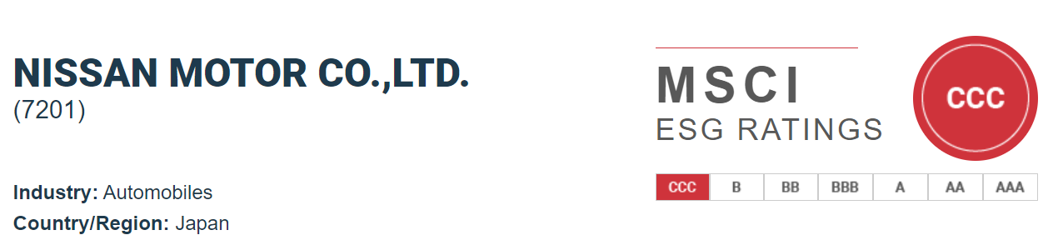
ESG Scores
Example of Divergence
The new Sustainalytics ratings use an inverted scale
S&P
Sustainalytics
S&P
Refinitiv
Refinitiv
MSCI
MSCI

Slide 7
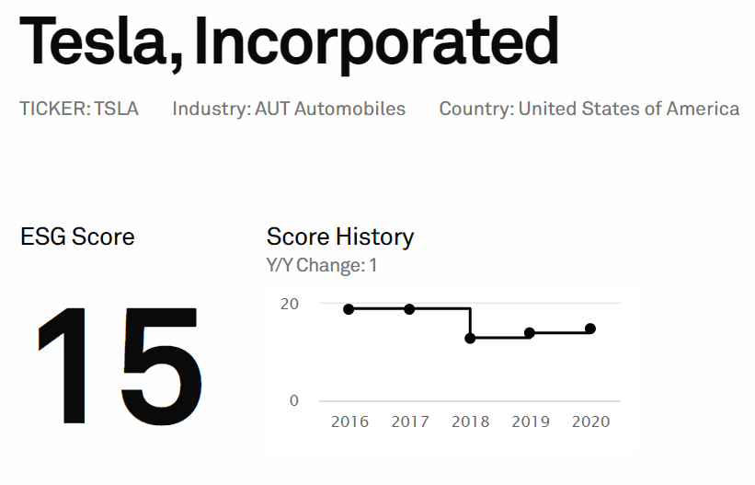
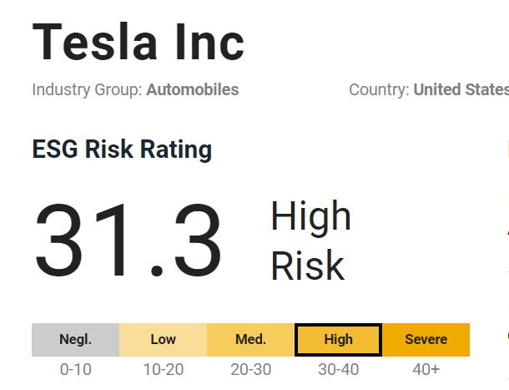
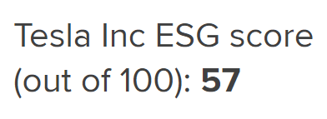
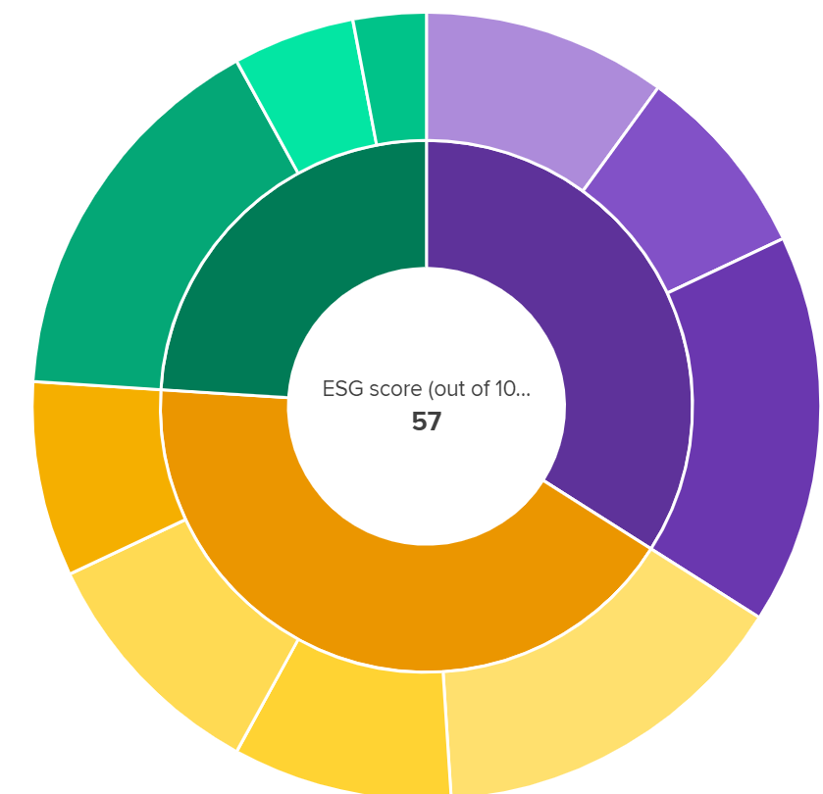
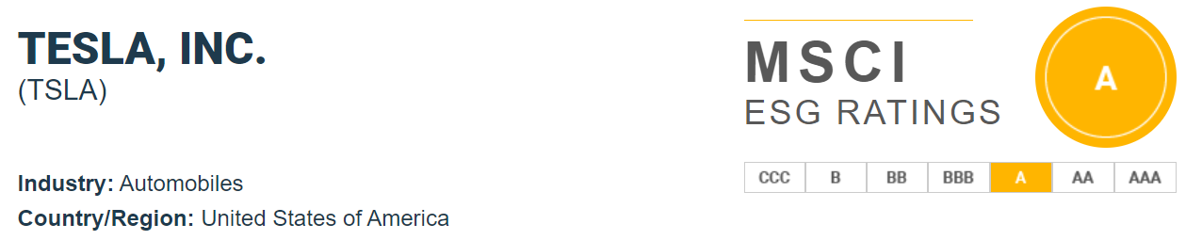
ESG Scores
Example of Divergence
The new Sustainalytics ratings use an inverted scale
S&P
Sustainalytics
S&P
Refinitiv
Refinitiv
MSCI
MSCI

Slide 12
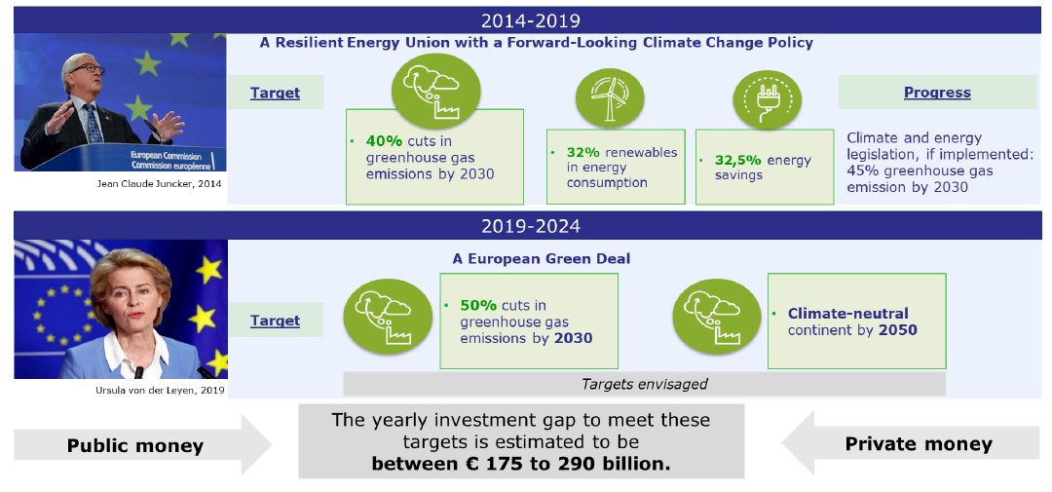
EU – Sustainable Finance Regulation

Slide 13
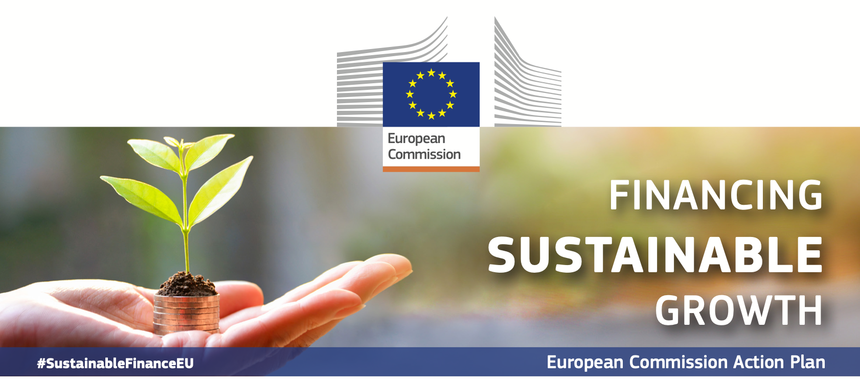


The EU Sustainable Finance Agenda
The Sustainable Finance Action Plan forms part of a broader policymaking agenda that is scoped by the December 2019 European Green Deal.
Objectives of the 2018 Action Plan
Reorient capital flows towards sustainable investment
Manage financial risks stemming from climate change and other environmental, social issues
Foster transparency and long-termism in financial economic activity
A Capital Markets Union
for people and businessses
New Action Plan
up next: Renwed Sustainable Finance Strategy

Slide 14
The ten actions proposed by the Action Plan
The action covered a lot of areas, not all related to disclosures. Most of them are about information.
1. Taxonomy
2. Standards & Labels
3. Fostering Sustainable Investment
4. Financial Advice
5. Sustainability Benchmarks
6. Credit and Sustainability Ratings
7. Risk-related Duties
8. Prudential Regulation
9. Accounting & Disclosure
10. Corporate Short-Termism
Reorient capital
Manage risk
Foster transparency

Slide 15
Sustainabel Finance EU Regulation
EU taxonomy for sustainable activities
What the EU is doing to create an EU-wide classification system for sustainable activities.
EU Green Bond Standard
How an EU-wide standard could encourage market participants to issue & invest in EU green bonds and improve the effectiveness & credibility of the market.
Corporate disclosure of climate-related information
Guidance for companies on how to report on the impacts of their business on the climate and on the impacts of climate change on their busines
EU climate benchmarks and benchmarks’ ESG disclosures
Make benchmark methodologies more transparent when it comes to ESG factors & put forward standards for the methodology of low-carbon benchmarks in the EU.
Sustainability-related disclosure in the financial services sector
What the obligations are for manufacturers of financial products and financial advisers towards end-investors

