Slide 1
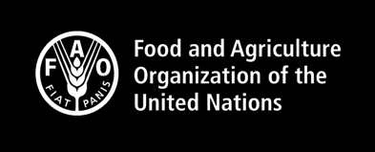

Right to Food: What Role for Catholic Social Thought
and Faith Communities?
The Human Right to Adequate Food
11 Sept 2025
Juan Echanove
Right to Food Team Leader
Rural Transformation and Gender Equality Division
Food and Agriculture Organization of the United Nations (FAO)
Notes:
FAO is the United Nations specialized agency with the mandate to end hunger and malnutrition in all its forms, strengthen food security and healthy diets, and promote agriculture and sustainable development.
Its ultimate vision for a world free from hunger and towards sustainable agrifood systems is intrinsically connected to the socioeconomic conditions of rural and urban actors and the protection of their rights.
FAO plays a central role in the realization of human rights, most notably the right to adequate food.
The FAO Right to Food Team is dedicated to increasing awareness and understanding among policy makers and local actors on the value and importance of integrating human rights principles and the RTF at the core of agrifood systems transformation.

Slide 2
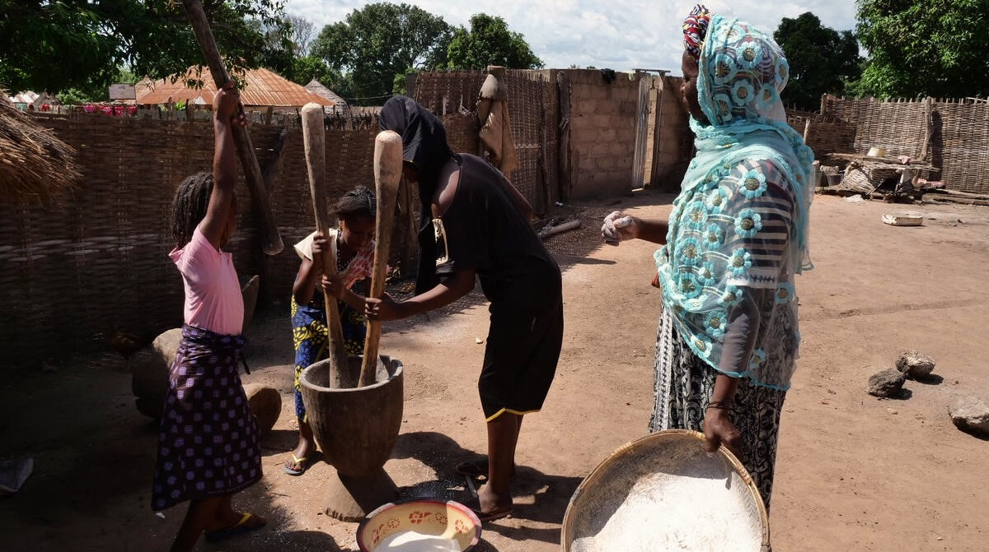

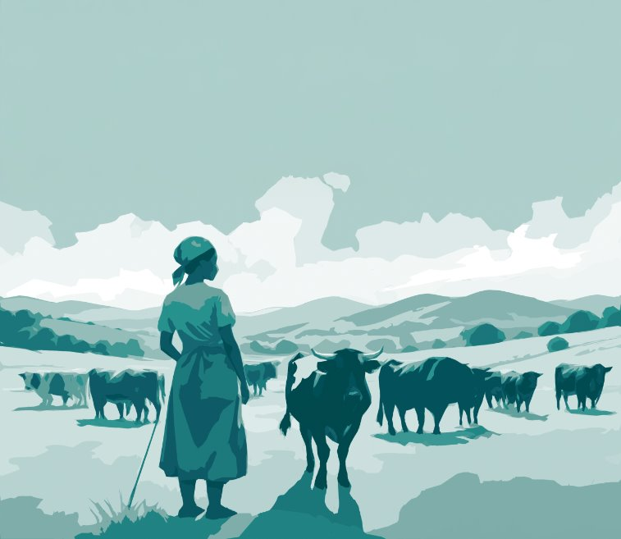
Content
Part I:
What is the Right to Food?
Part II:
Historical background
Part III:
Right to Food and Catholic Social Thought
Part IV:
The Right to Food team of FAO
Notes:
Part I – Introduction to the RTF
Concept and history of the right to food
International legal framework
State obligations
Food security and the right to food
How to implement the right to food
The RTF Guidelines
The role of the RTF Team in FAO
Part II – Right to food in practice

Slide 3

Part I : What is the right to Food?
Notes:
Part I – Introduction to the RTF
Concept and history of the right to food
International legal framework
State obligations
Food security and the right to food
How to implement the right to food
The RTF Guidelines
The role of the RTF Team in FAO
Part II – Right to food in practice

Slide 4
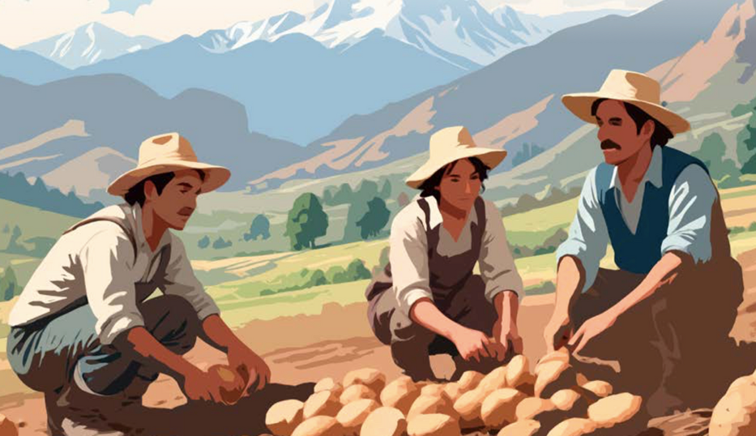
What is the Right to Food?
The right to food is realized when every man, woman and child alone or in community with others (all people) have physical and economic access at all times to adequate food or the means for its procurement.
Everyone has the right - there can be no discrimination.
(Committee on Economic, Social, and Cultural Rights, General Comment 12, 1999)

Slide 5
The Right to Food and Food Security
Right to Food
Legal obligation/entitlement
Food Security
State of being/situation
Notes:
Human right ICESCR :
An obligation of states
Dignity, empowerment and Accountability
Immediate duty to prevent hunger and continuous obligation to progressively realize the right
Universal, interdependent, interconnected, eg ensure health and well-being.
Connects to all human rights
Food security is a state of being.
Consider someone in a refugee camp – their food and nutrition needs may be met but they are not enjoying realization of the right to adequate food

Slide 6

The Right to Food is all about two words
Dignity
The right to food ensures access to food in a way that respects people’s self-worth, not as charity.
Entitlement
It gives individuals a legal claim to food, making it a State’s obligation.
Notes:
In essence the RTF is about 2 words – dignity and entitlement - it is a right not a charity.
The right to food is about feeding oneself or providing for oneself it is not about charity
Where there is a right, there must be a remedy

Slide 7
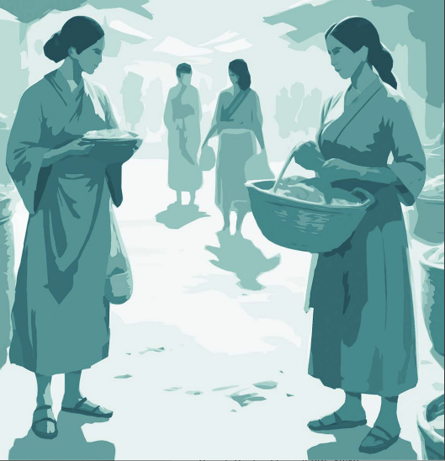
Human Rights Principles
Rights-based principles to guide legislative and policy development and implementation
Participation and Inclusion
Accountability
Non-discrimination and Equality
Transparency
Human dignity
Empowerment and Agency
Rule of law
Notes:
Human rights are universal, interdependent and interconnected.
The right to food is connected to numerous rights eg. the right to health, the right to work, the right to shelter, the right to an adequate standard of living and the right to life itself.
The human rights-based approach requires us to consider development within a context of international law, with the aim to ensure the realization of international legal standards, and to raise the capacity of duty bearers, or states, to meet their obligations and to respect, protect and fulfiil human rights for all, and the capacity of rights holders to know about and claim their rights
In FAO, to describe the human rights-based principles, we use the acronym PANTHER principles.
This helps to distinguish the difference between FSN and RTF
When giving the presentation: mention the examples of 35 and 36.

Slide 8

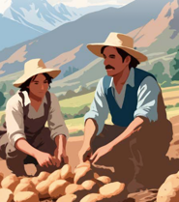


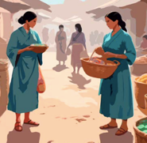



Rights Holders
(including groups in vulnerable situations)
Duty Bearers
National governments
Producers and
rural populations
United Nations
Donors
Consumers
Local governments
Agrifood systems workers
Private sector
Notes:
Highlight women, Indigenous Peoples, and youth.

Slide 9





Key State obligations under the RTF
ICESCR and General Comment 12
Respect, protect, and fulfill the RTF
Ensure food availability through natural resources or markets
Food must be physically and economically accessible to all…
…in a way that ensures long-term sustainability
Nutritionally adequate, safe and culturally appropriate

Slide 10






Key State obligations under the RTF
ICESCR and General Comment 12
Without discrimination, especially for groups in vulnerable situations
Progressively realize the RTF using max. available resources
Obligation to prevent violations of the RTF
Eliminating hunger is a core obligation
Engage in international cooperation to support RTF
Individuals have the right to legal remedies if RTF violated

Slide 11
Recourse mechanisms in case of violation of the Right to Food
Individuals can bring claims to national courts or human rights institutions.
National
Individuals can bring cases before Human Rights Commissions or regional courts (Eg ECtHR) when redress cannot be obtained at the national level.
Regional
International
Individuals can approach international human rights complaint mechanisms such as the complaint procedure of the Human Rights Council, the Human Rights Treaties of the Special Procedures. In some cases, Individuals can also bring cases before the International Court of Justice.

Slide 12

Common RTF Misconceptions
Misconceptions | Reality
RTF is a generic, vague term | The RTF is a very precisely defined concept in international law.
RTF is just about providing food | The RTF is about access to adequate, nutritious food respecting dignity, and addressing inequality. Not just handing out food.
RTF is only a legal issue | While the RTF is supported by legal frameworks, it is also a practical policy tool.
RTF equals food security | Food security focuses on availability, access, stability. RTF includes legal and policy obligations to ensure access in an equitable manner.
RTF is a sector or theme | The RTF is a cross-cutting issue, relevant to all aspects of food security, nutrition, and food systems.

Slide 13
Part II : Historical background
Notes:
Part I – Introduction to the RTF
Concept and history of the right to food
International legal framework
State obligations
Food security and the right to food
How to implement the right to food
The RTF Guidelines
The role of the RTF Team in FAO
Part II – Right to food in practice

Slide 14
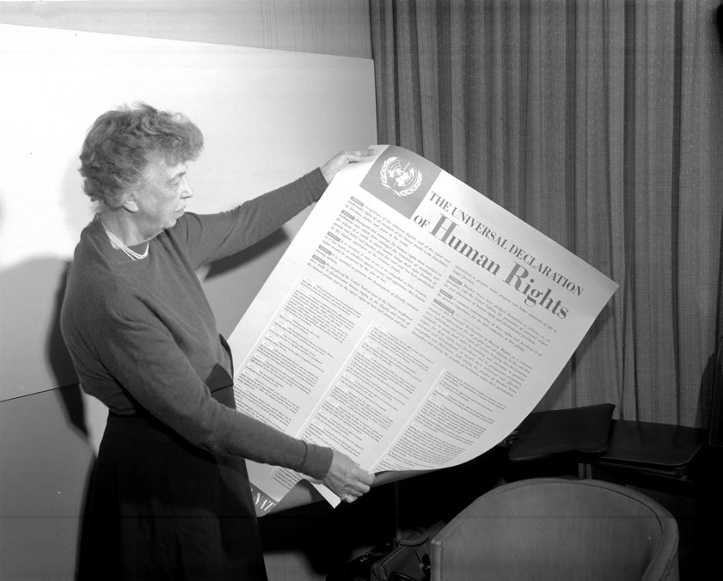
The human rights framework
1948
Universal Declaration of Human Rights (1948)​
Article 25​
1966
International Covenant on Civil and Political Rights (1966)​
1966
International Covenant on Economic, Social and Cultural Rights (1966)​
Article 11
Notes:
Part I – Introduction to the RTF
Concept and history of the right to food
International legal framework
State obligations
Food security and the right to food
How to implement the right to food
The RTF Guidelines
The role of the RTF Team in FAO
Part II – Right to food in practice

Slide 15
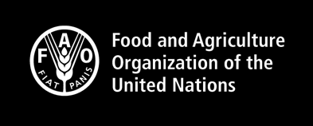
Related Normative Framework
Convention on the Elimination of All Forms of Discrimination against Women (1979)
Convention on the Rights of the Child (1989)
Convention on the Rights of Persons with Disabilities (2006)
Protocol of San Salvador (1988)
African Charter on the Rights and Welfare of the Child (1990)
Protocol to the African Charter on Human and Peoples’ Rights on the Rights of Women in Africa (2003)
UN Declaration on the Rights of Indigenous Peoples (UNDRIP) 2008​
UN Declaration on the Rights of Peasants and Other People Working in Rural Areas (UNDROP) 2018​
General Recommendation No. 34 on the rights of rural women etc
CFS Gender Equality and Women’s and Girl’s Empowerment Guidelines
CFS Policy Recommendations on Promoting Youth Engagement and Employment in Agriculture and Food Systems for FSN
CFS-Guidelines on Food Systems and Nutrition
CFS Framework for action for FSN in Protracted Crises
ILO conventions and recommendations
UN Guiding Principles on Business and Human Rights

Slide 16







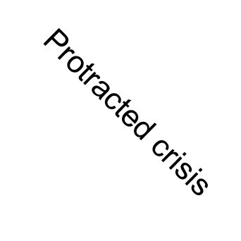
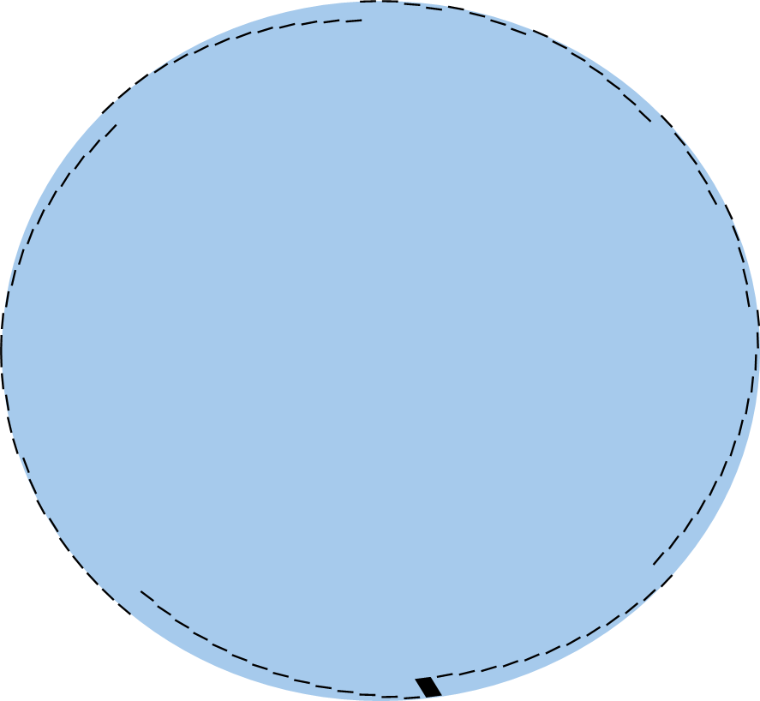










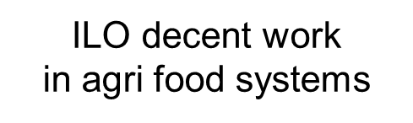

RTF Advanced Normative Framework
Legally
binding
(enforceable obligations)
International Covenant on Economic, Social,
Cultural Rights (ICESCR, 1966):
RtF as a legal obligation for states
CESCR General Comment 12 (1999):
Clarifies states’ obligations
Voluntary Guidelines to Support the Progressive Realization of the Right
to Adequate Food (2004)
Non-binding guidelines
and principles
Other Voluntary Guidelines in specific areas
Notes:
Human right ICESCR :
An obligation of states
Dignity, empowerment and Accountability
Immediate duty to prevent hunger and continuous obligation to progressively realize the right
Universal, interdependent, interconnected, eg ensure health and well-being.
Connects to all human rights

Slide 17
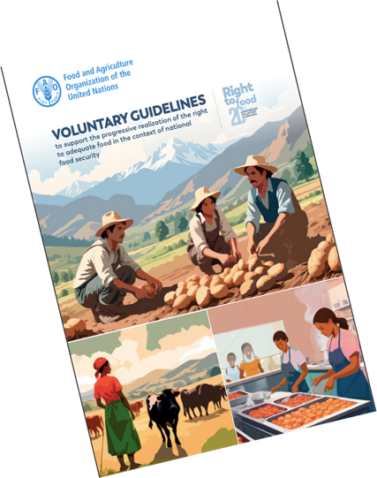
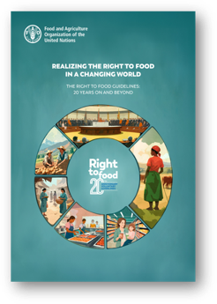
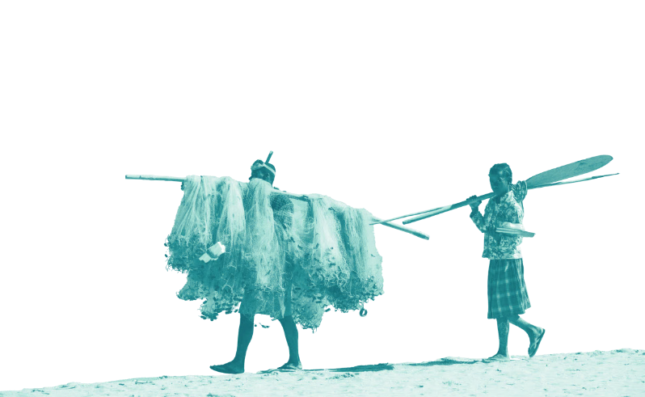
The Right to Food Guidelines
The RTFG cover the full range of actions to be considered by governments at the national level to build an enabling environment for people to feed themselves in dignity and to establish appropriate safety nets for those who are unable to do so.
  Tackling the root causes of hunger
  19 guidelines provide practical orientation to States on how to implement right to food obligations ​
  Guidance on an enabling environment​
  Voluntary, but based on binding legal obligations and the application of Human Rights principles​
  “Mother of all Guidelines“: Spearheaded the development of other tools
Notes:
Part I – Introduction to the RTF
Concept and history of the right to food
International legal framework
State obligations
Food security and the right to food
How to implement the right to food
The RTF Guidelines
The role of the RTF Team in FAO
Part II – Right to food in practice

Slide 18
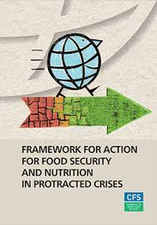
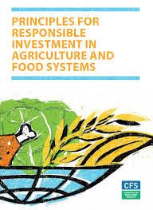
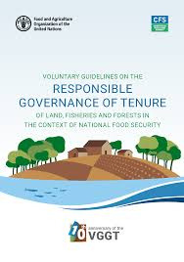
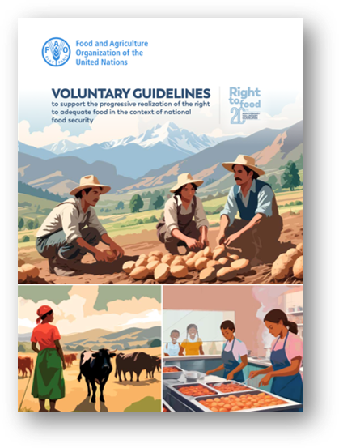

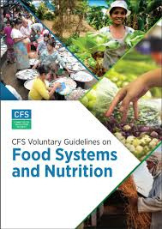
Right to Food Guidelines
Notes:
Other documents: advanced framework

Slide 19
Part III Right to Food and Catholic Social Thought
Notes:
Part I – Introduction to the RTF
Concept and history of the right to food
International legal framework
State obligations
Food security and the right to food
How to implement the right to food
The RTF Guidelines
The role of the RTF Team in FAO
Part II – Right to food in practice

Slide 20
Both the Right to Food and Catholic Social Thought are grounded in the inherent dignity of the human person.
Preferential Option for the Poor → Those most vulnerable to hunger deserve priority in policies and practices.
Solidarity → Hunger is not just a technical issue but a moral scandal that requires collective responsibility.
Common Good → Access to adequate food is a condition for social peace and justice.
Notes:
Part I – Introduction to the RTF
Concept and history of the right to food
International legal framework
State obligations
Food security and the right to food
How to implement the right to food
The RTF Guidelines
The role of the RTF Team in FAO
Part II – Right to food in practice

Slide 21
Subsidiarity → Empower local communities, small-scale farmers, and families in food production and governance.
Stewardship of Creation → Food systems must respect the earth and future generations.
Both frameworks call for policies that put people before profit.
Both see participation of those affected as essential — whether in food policy councils or synodal processes.
Both reject hunger as inevitable: it is a matter of justice, solidarity,
and governance.
Notes:
Part I – Introduction to the RTF
Concept and history of the right to food
International legal framework
State obligations
Food security and the right to food
How to implement the right to food
The RTF Guidelines
The role of the RTF Team in FAO
Part II – Right to food in practice

Slide 22
Part IV The Right to Food team of FAO
Notes:
Part I – Introduction to the RTF
Concept and history of the right to food
International legal framework
State obligations
Food security and the right to food
How to implement the right to food
The RTF Guidelines
The role of the RTF Team in FAO
Part II – Right to food in practice

Slide 23

FAO RTF Team Areas of work
Awareness raising and communication | Capacity development | Advocacy and policy making | Training
PROVIDING TECHNICAL ASSISTANCE for:
Enhanced RTF Implementation
  Policies and legislation
  Access to Justice
  Social accountability
  Monitoring and reporting
Better capacities
  Trainings,
  Awareness raising
  E-learnings
FOR: Better Production, Better Nutrition, Better Environment and better lives for all.
Thematic sessions:
  Right to food in conflicts and crises
  Right to food in urban and peri-urban areas (local governance)
  Right to food and nutrition
Projects:
  FARE
  Food Systems Clinics
  Networks
Partnering with UN, CSOs ,Consumers, Parliamentarians, Academics, Governments, Rome Group of Friends of Right to the Food
Notes:
How is it done?

Slide 24
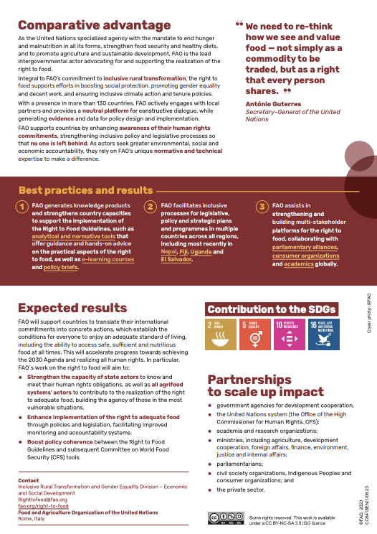
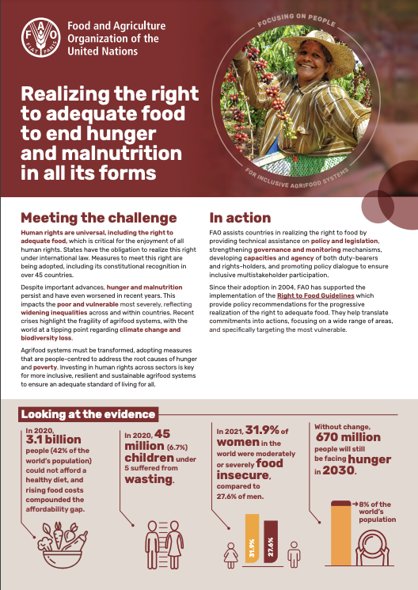
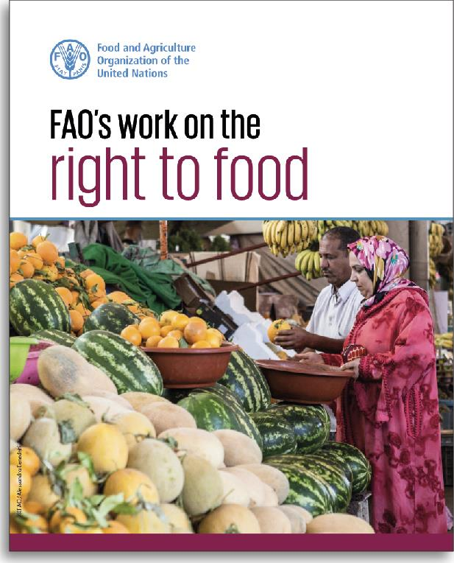
The Right to Food Team at FAO

Slide 25
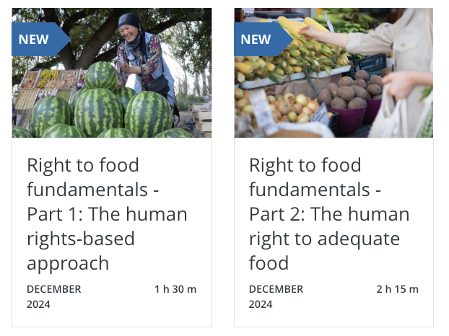


Want to know more about the right to food ?
Access the course here!
Notes:
Get certified!

Slide 26

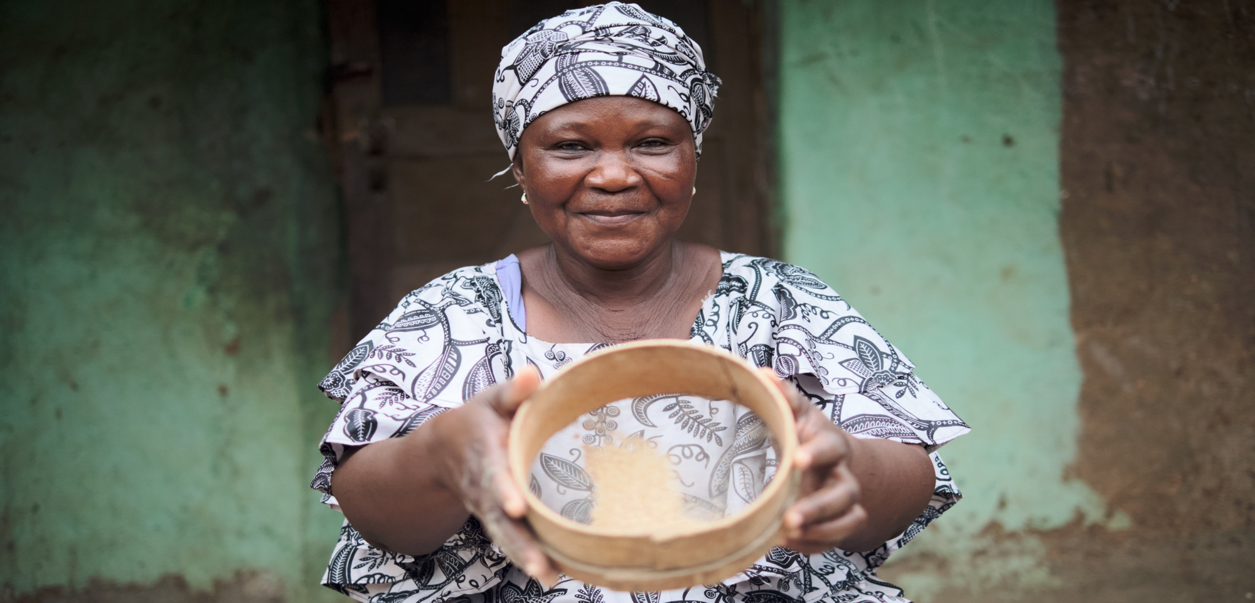
Thank you
Thank you
Notes:
Q&A Part II:
How to persuade host countries

