Slide 1

Webinar Fondazione Centesimus Annus Pro Pontifice
September 25th 2025
Sr Nathalie Becquart, xmcj, Under-Secretary
to the General Secretariat for the Synod
Notes:
Current developments, key challenges and future perspectives of synodality

Slide 2
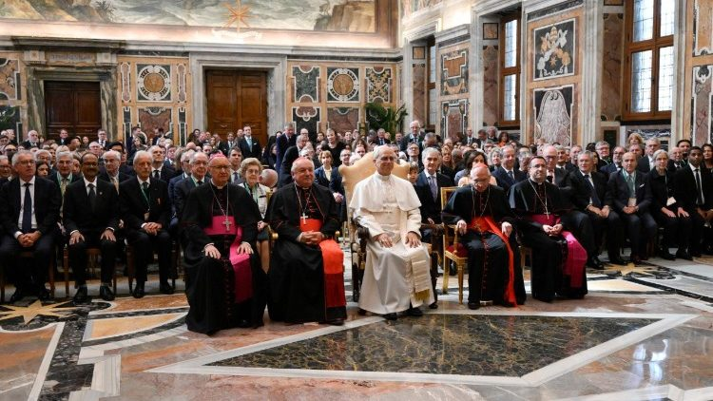
Starter
1’ in silence
When you think about your experience or understanding of Pope Leo XIV, what do you have in mind ?
Notes:
Pope Leo to the Diocese of Rome
"Through the synodal process, the Spirit has aroused the hope of an ecclesial renewal, capable of revitalizing communities, so that they may grow in evangelical style, in closeness to God and in a presence of service and witness in the world. The fruit of the synodal journey, after a long period of listening and dialogue, has been first and foremost the impulse to enhance ministries and charisms, drawing from the baptismal vocation, placing at the center the relationship with Christ and the welcoming of brothers and sisters, starting with the poorest, sharing their joys and sorrows, hopes and struggles. In this way, the sacramental character of the Church is highlighted, which, as a sign of God's love for humanity, is called to be a privileged channel so that the living water of the Spirit can reach everyone. This requires the exemplarity of the holy people of God. As we know, sacramentality and exemplarity are two key concepts of the ecclesiology of Vatican II and of Pope Francis's hermeneutics. You will remember how dear to him was the patristic theme of the mysterium lunae, that is, the Church seen in the reflection of Christ's light, of the relationship to Him, sun of justice and light of the nations.

Slide 3
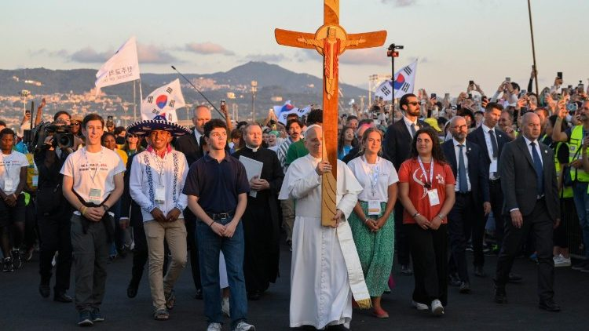
Journeying together with a new Pope
The conciliar vision of a Church in the world, in dialogue with everyone, and with the entire community
“The Church’s synodality, thus, becomes a social prophecy for today’s world, inspiring new paths in the political and economic spheres, as well as collaborating with all those who believe in fellowship and peace in an exchange of gifts with the world”
https://www.synod.va/content/dam/synod/news/2024-10-26_final-document/ENG---Documento-finale.pdf

Slide 4
Pope Leo XIV
“Sensing myself called to continue in this same path, I chose to take the name Leo XIV. There are different reasons for this, but mainly because Pope Leo XIII in his historic Encyclical Rerum Novarum addressed the social question in the context of the first great industrial revolution. In our own day, the Church offers to everyone the treasury of her social teaching in response to another industrial revolution and to developments in the field of artificial intelligence that pose new challenges for the defence of human dignity, justice and labour.”
Meeting with the College of Cardinals, 10.05.2025
https://press.vatican.va/content/salastampa/en/bollettino/pubblico/2025/05/10/250510a.html

Slide 5
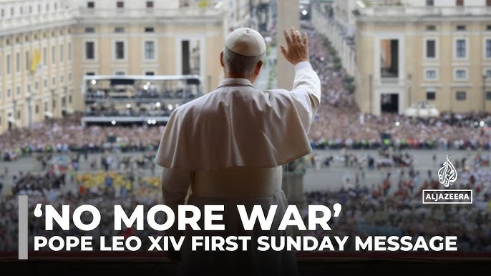
A focus on peace : the priority mission of the Church in this world
Elected May 8, Regina Caeli May 11
“After the Regina Caeli Brothers and sisters, the immense tragedy of the Second World War ended 80 years ago, on May 8, after causing 60 million victims. In today's dramatic scenario of a piecemeal third world war, as Pope Francis has repeatedly stated, I too address the great ones of the world, repeating the ever-timely appeal: "Never again war!“” https://www.vatican.va/content/leo-xiv/en/angelus/2025/documents/20250511-regina-caeli.html

Slide 6
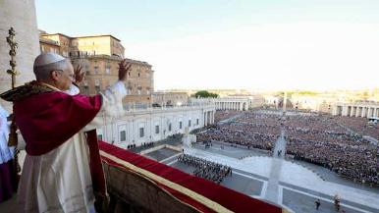

“Peace be with you all!”
“So, let us move forward, without fear, together, hand in hand with God and with one another other!
“With you I am a Christian, and for you I am a bishop.” In this sense, all of us can journey together toward the homeland that God has prepared for us. “
Together, we must look for ways to be a missionary Church, a Church that builds bridges and encourages dialogue, a Church ever open to welcoming, like this Square with its open arms, all those who are in need of our charity, our presence, our readiness to dialogue and our love.
“To all of you, brothers and sisters in Rome, in Italy, throughout the world: we want to be a synodal Church, a Church that moves forward, a Church that always seeks peace, that always seeks charity, that always seeks to be close above all to those who are suffering.” https://press.vatican.va/content/salastampa/it/bollettino/pubblico/2025/05/08/0299/00524.html
Notes:
Peace be with you all!
Dear brothers and sisters, these are the first words spoken by the risen Christ, the Good Shepherd who laid down his life for God’s flock. I would like this greeting of peace to resound in your hearts, in your families, among all people, wherever they may be, in every nation and throughout the world. Peace be with you!
It is the peace of the risen Christ. A peace that is unarmed and disarming, humble and persevering. A peace that comes from God, the God who loves us all, unconditionally.
We can still hear the faint yet ever courageous voice of Pope Francis as he blessed Rome, the Pope who blessed Rome, who gave his blessing to the world, the whole world, on the morning of Easter. Allow me to extend that same blessing: God loves us, God loves you all, and evil will not prevail! All of us are in God’s hands. So, let us move forward, without fear, together, hand in hand with God and with one another other! We are followers of Christ. Christ goes before us. The world needs his light. Humanity needs him as the bridge that can lead us to God and his love. Help us, one and all, to build bridges through dialogue and encounter, joining together as one people, always at peace. Thank you, Pope Francis!
I also thank my brother Cardinals, who have chosen me to be the Successor of Peter and to walk together with you as a Church, united, ever pursuing peace and justice, ever seeking to act as men and women faithful to Jesus Christ, in order to proclaim the Gospel without fear, to be missionaries.
I am an Augustinian, a son of Saint Augustine, who once said, “With you I am a Christian, and for you I am a bishop.” In this sense, all of us can journey together toward the homeland that God has prepared for us.
A special greeting to the Church of Rome! Together, we must look for ways to be a missionary Church, a Church that builds bridges and encourages dialogue, a Church ever open to welcoming, like this Square with its open arms, all those who are in need of our charity, our presence, our readiness to dialogue and our love.
(In Spanish)
Y si me permiten también una palabra, un saludo a todos y en modo particular a mi querida diócesis de Chiclayo, en el Perú, donde un pueblo fiel ha acompañado a su obispo, ha compartido su fe y ha dado tanto, tanto, para seguir siendo Iglesia fiel de Jesucristo.
(Translation)
And if you also allow me a brief word, a greeting to everyone and in particular to my beloved Diocese of Chiclayo, in Peru, where a faithful people has accompanied its Bishop, shared its faith and given so much, so much, to continue being a faithful Church of Jesus Christ.
To all of you, brothers and sisters in Rome, in Italy, throughout the world: we want to be a synodal Church, a Church that moves forward, a Church that always seeks peace, that always seeks charity, that always seeks to be close above all to those who are suffering.
Today is the day of the Prayer of Supplication to Our Lady of Pompeii. Our Mother Mary always wants to walk at our side, to remain close to us, to help us with her intercession and her love. So I would like to pray together with you. Let us pray together for this new mission, for the whole Church, for peace in the world, and let us ask Mary, our Mother, for this special grace: Hail Mary...

Slide 7
Leadership for Peace and Unity
“So, now it is up to us to set to work so that the Church that lives in Rome may become a workshop of synodality, capable – with the grace of God – of realizing “acts of the Gospel” in an ecclesial context where there is no shortage of challenges, especially with regard to the transmission of the faith, in a city that is in need of prophecy, marked as it is by many and growing forms of economic and existential poverty, with young people often disoriented and families often burdened. A synodal Church in mission needs to equip itself to adopt a style that values the gifts of each person and understands the function of guide as a pacifying and harmonious exercise, so that, in the communion inspired by the Spirit, dialogue and relationships may help us to overcome the many pressures towards opposition or defensive isolation.”
Audience with the Diplomatic Corps, May 16, 2025
https://www.vatican.va/content/leo-xiv/en/speeches/2025/may/documents/20250516-corpo-diplomatico.html
Notes:
Audience with the Diplomatic Corps, May 16, 2025
In our dialogue, I would like us to keep in mind three essential words that represent the pillars of the Church's missionary activity and the aim of the Holy See's diplomacy. The first word is peace. All too often we consider it a "negative" word, indicative only of the absence of war and conflict, since opposition is a perennial part of human nature, frequently leading us to live in a constant "state of conflict" at home, at work and in society. Peace then appears simply as a respite, a pause between one dispute and another, given that, no matter how hard we try, tensions will always be present, a little like embers burning beneath the ashes, ready to ignite at any moment. From a Christian perspective -- but also in other religious traditions -- peace is first and foremost a gift. It is the first gift of Christ: "My peace I give to you" (Jn 14:27). Yet it is an active and demanding gift. It engages and challenges each of us, regardless of our cultural background or religious affiliation, demanding first of all that we work on ourselves. Peace is built in the heart and from the heart, by eliminating pride and vindictiveness and carefully choosing our words. For words too, not only weapons, can wound and even kill.
https://press.vatican.va/content/salastampa/it/bollettino/pubblico/2025/09/19/0660/01164.html

Slide 8
Peace Begins with Us and Within Us
“In the "Sermon on the Mount" Jesus proclaimed: "Blessed are the peacemakers" (Mt 5:9). This is a Beatitude that challenges us all and concerns you closely, calling each person to the commitment of carrying forward a different communication, one that does not seek consensus at all costs, does not clothe itself in aggressive words, does not embrace the model of competition, never separates the search for truth from the love with which we must humbly seek it. Peace begins with each of us: from the way we look at others, listen to others, speak about others; and, in this sense, the way we communicate is of fundamental importance: we must say "no" to the war of words and images, we must reject the paradigm of war.”
“You are on the front lines in narrating conflicts and hopes for peace, situations of injustice and poverty, and the silent work of so many for a better world. For this reason I ask you to choose with awareness and courage the path of communication for peace.”
Meeting with media representatives gathered in Rome for the Conclave, May 12, 2025
https://press.vatican.va/content/salastampa/it/bollettino/pubblico/2025/05/12/0309/00533.html#en

Slide 9
Listening to Pope Leo XIV as Foundation
The Culture of Encounter as Foundation
Listening to Existential Peripheries
Dialogue as Ecclesial Method
“I invite you, then, to participate actively and creatively in this discernment process, and thus contribute, with all of God’s people, to the development of the Church’s social doctrine in this age of significant social changes, listening to everyone and engaging in dialogue with all. In our day, there is a widespread thirst for justice, a desire for authentic fatherhood and motherhood, a profound longing for spirituality, especially among young people and the marginalized, who do not always find effective means of making their needs known. There is a growing demand for the Church’s social doctrine, to which we need to respond.”
address of his holiness pope leo xiv to members of the "centesimus annus pro pontifice" foundation
https://www.vatican.va/content/leo-xiv/en/speeches/2025/may/documents/20250517-centesimus-annus-pro-pontifice.html
Notes:
1. The Culture of Encounter as Foundation
The Pope explicitly evokes the necessity of building a "culture of encounter" through dialogue and social friendship. This approach perfectly reflects the essence of synodality, which invites us to "walk together" in mutual listening and authentic encounter.
2. Listening to Existential Peripheries
The emphasis placed on the importance of listening to the poor and marginalized - "Let the voice of the poor be heard" - corresponds directly to the synodal dimension of including all voices, particularly those who are usually excluded from ecclesial decision-making processes.
3. Dialogue as Ecclesial Method
In this regard, I would like us to renew together today our complete commitment to the path that the universal Church has now followed for decades in the wake of the Second Vatican Council. Pope Francis masterfully and concretely set it forth in the Apostolic Exhortation Evangelii Gaudium, from which I would like to highlight several fundamental points: the return to the primacy of Christ in proclamation (cf. No. 11); the missionary conversion of the entire Christian community (cf. No. 9); growth in collegiality and synodality (cf. No. 33); attention to the sensus fidei (cf. Nos. 119-120), especially in its most authentic and inclusive forms, such as popular piety (cf. No. 123); loving care for the least and the rejected (cf. No. 53); courageous and trusting dialogue with the contemporary world in its various components and realities (cf. No. 84; SECOND VATICAN COUNCIL, Pastoral Constitution Gaudium et Spes, 1-2)

Slide 10
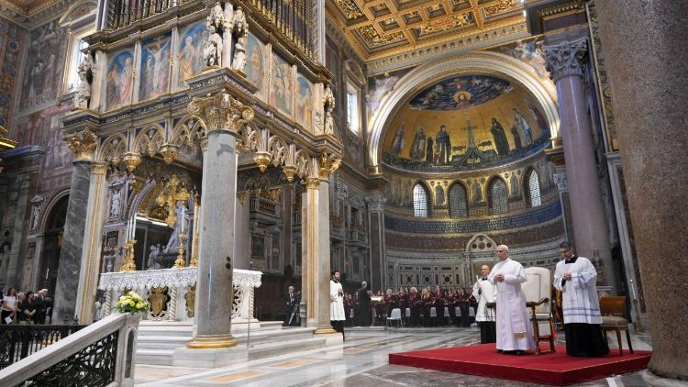
How to move forward?

Slide 11
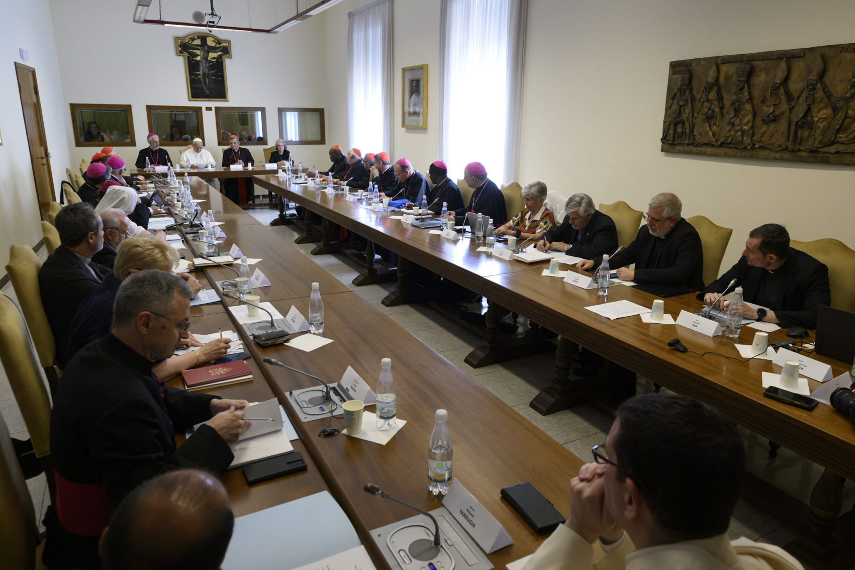
Listening and consulting, discerning with synodal structures and processes

Slide 12
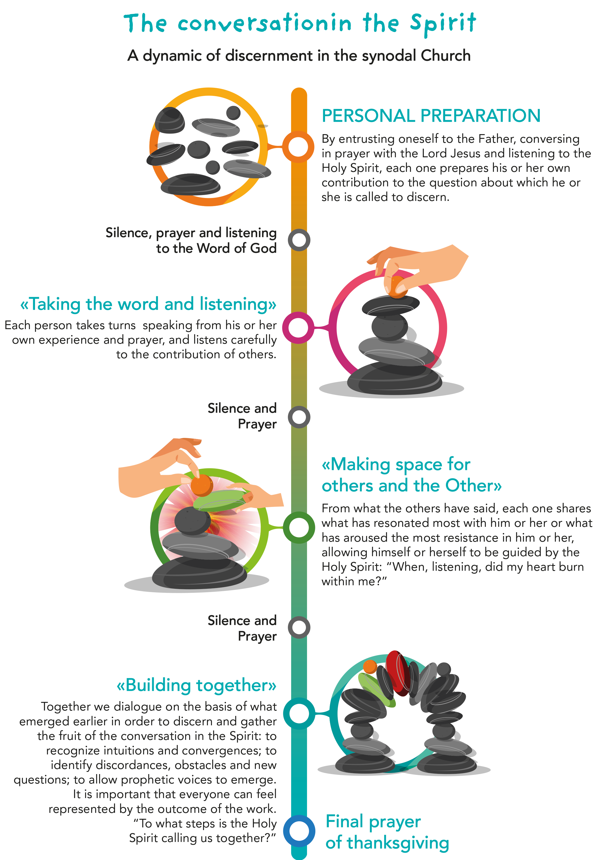
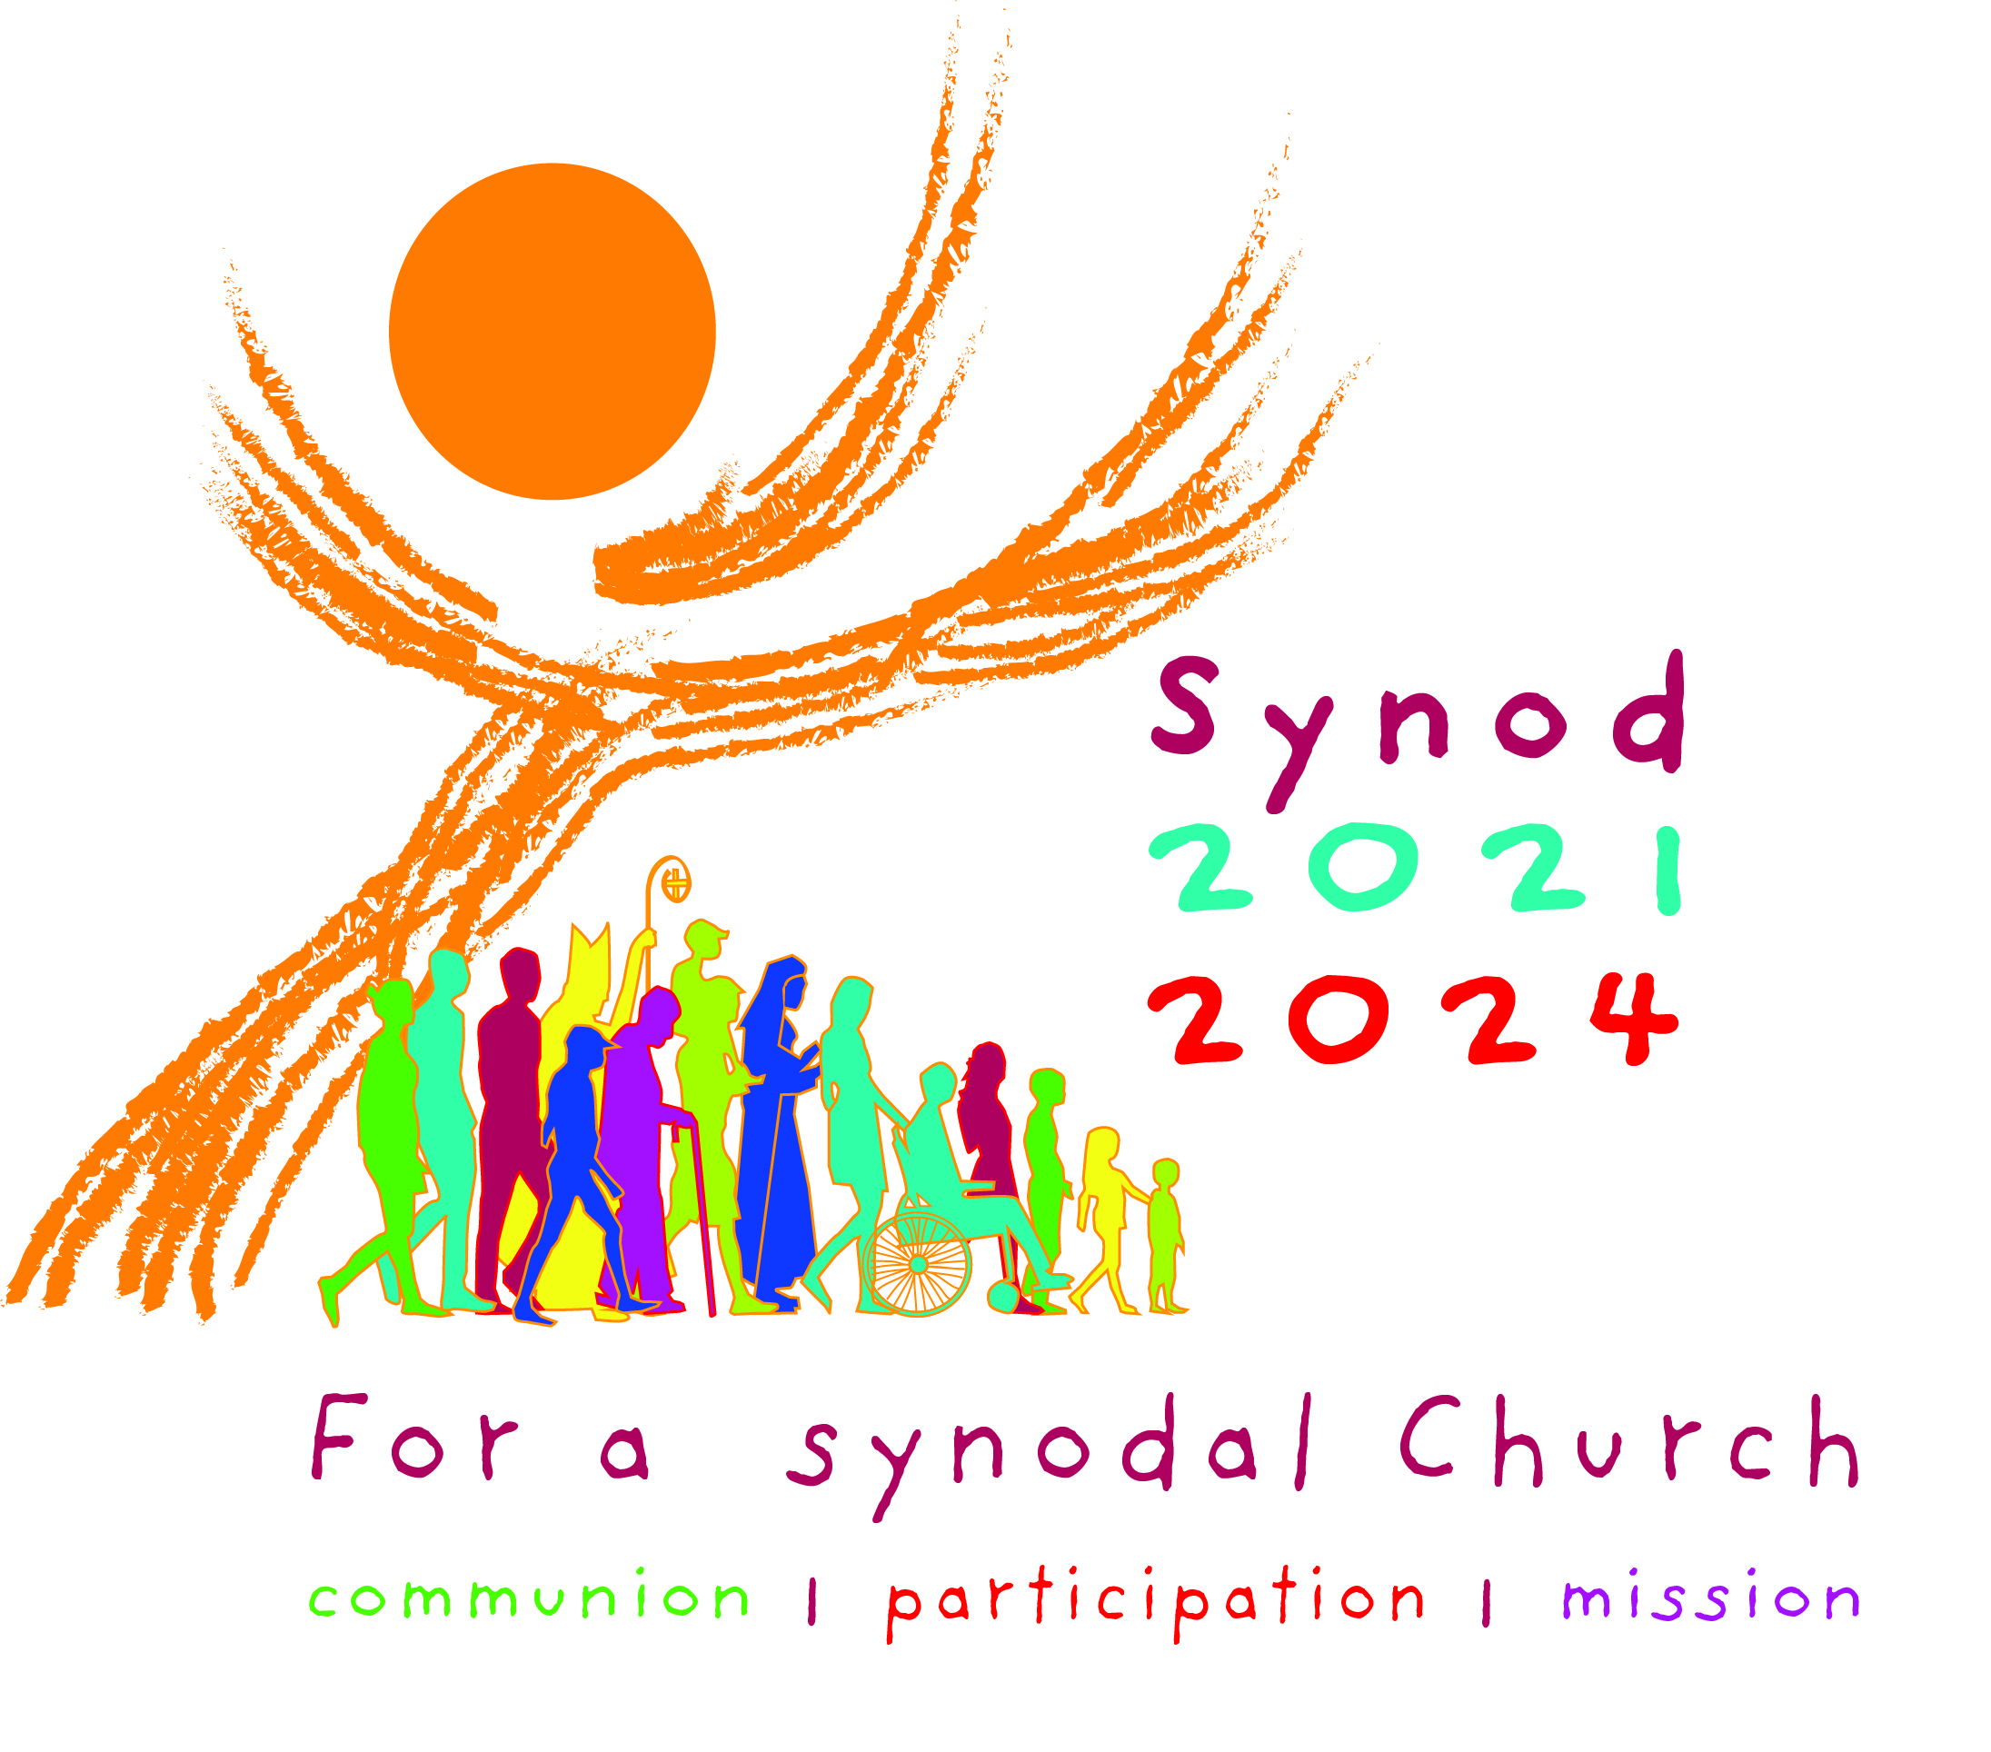
A way forward for the synodal Church: conversation in the Spirit
Notes:
A relational anthropology
Convergences between developmental science/neurosciences/ and Christian anthropology
Understanding based on reciprocity, humans are embodied, holistic, relational and non-reductible organisms
Human being are created men and women at the image of God, with a vocation for communion
human beings are fundamentally relational
Human beings are made for love and friendships, for relationships of mutuality
Human beings need to be seen holistically as an embodiment spiritual thoughtful being
Human beings are vulnerable and fragile, imperfect and incomplete and imperfect → they need the others
Human beings are interdependent and interconnected
Human beings flourished by participating to network of giving and receiving care
Human beings are deeply interconnected with the rest of creation
“becoming one’s best self with and for others, and with a higher purpose”
Human culture is dynamic
EG “ we are all part of a journeying community”
The model of a pluriform unity

Slide 13
A synodal approach to designing and accompanying processes
a) processes of ecclesial discernment
b) processes of training courses on synodality
c) processes and experiences of listening and dialogue in communities
d) celebrations, encounters and exchanges of experiences between communities within a diocese or between dioceses in the same region.
e) communication processes and activities, aimed both at Christian communities and at the societies in which they live
f) paths for renewing pastoral action in a concrete area or on a theme relevant to each local Church (e.g., promoting more lively participation in the Sunday celebration, catechetical programmes, ecumenical dialogue, integration of migrants, commitment to caring for our common home, etc.), implementing initiatives that make the impact of a synodal approach tangible and verifying their results. This can help translate the horizon of synodality into the concrete life of communities;
g) theological, pastoral and canonical research paths at the service of the implementation of the Synod in the specific aspects of the local context and in dialogue between the Churches.
PATHWAYS FOR THE IMPLEMENTATION PHASE OF THE SYNOD 2025 - 2028 www.synod.va/content/dam/synod/process/implementation/pathways/250102---ENG-Pathways-for-the-implementation-phase.pdf
Notes:
4.2. A synodal approach to designing and accompanying processes These methodological guidelines can be applied in a variety of situations and processes, characterised by different objectives, but united by the fact that they are carried out in a synodal way. In order to implement them while avoiding the risk of improvisation and dispersion, it is advisable to invest in the design and accompaniment of these processes. Here are a few examples, without claiming to be in any way exhaustive: a) processes of ecclesial discernment, both to identify the priorities of the mission and to identify forms and procedures of governance appropriate to a synodal Church. Each of these two elements has specific requirements that will need to be taken into account in planning the journey forward. The design and accompaniment of these processes will require the availability of experienced people who are capable of helping to implement the guidelines outlined above; b) processes of training courses on synodality according to the suggestions of Part V of the FD, also with regard to the variety of formation needs to be addressed and, consequently, making an effort to clarify the specific objectives of each path. Often, the most effective formation methodology is sharing and reflection in an atmosphere of prayer on the experiences lived as synodal Church, allowing their strengths and weaknesses to emerge. For this reason, reflection on ecclesial discernment processes, on synodal decision-making processes or on the functioning of participatory bodies can have a stronger formative value than a course organised according to traditional models. Here too, it will be crucial to have expert facilitators. It will therefore also be necessary to provide training for these figures; c) processes and experiences of listening and dialogue in communities, at a local and at a regional level. Experience has shown that digital tools can also be an important resource for this purpose. In the spirit already mentioned, it is important to carry out these experiences in a climate of prayer and to allow time for shared reflection so that their fruits can be appreciated; d) celebrations, encounters and exchanges of experiences between communities within a diocese or between dioceses in the same region. Here too, digital tools can be helpful, but we should not underestimate the potential of events linked to popular piety, such as pilgrimages to shrines, which often bring together large numbers of people. How can these events be animated in such a way that they take on a more explicit synodal character and foster encounter and dialogue among people? e) communication processes and activities, aimed both at Christian communities and at the societies in which they live, using the most appropriate means for each context. It will also be useful to explore the potential of new digital communication channels, which today constitute for some, especially young people, genuine environments in which to live and build relationships, in which the proclamation of the Gospel can be appropriately echoed. The experience of a digital Synod is a resource in this regard; 23 f) paths for renewing pastoral action in a concrete area or on a theme relevant to each local Church (e.g., promoting more lively participation in the Sunday celebration, catechetical programmes, ecumenical dialogue, integration of migrants, commitment to caring for our common home, etc.), implementing initiatives that make the impact of a synodal approach tangible and verifying their results. This can help translate the horizon of synodality into the concrete life of communities; g) theological, pastoral and canonical research paths at the service of the implementation of the Synod in the specific aspects of the local context and in dialogue between the Churches. With this important service, theologians «help the People of God to develop an understanding of reality enlightened by Revelation and to develop suitable responses and the appropriate language for mission» (FD, no. 67). This also generates a particular responsibility on the part of theological institutions to accompany the Church in living the synodal dimension ever more fully. The synodal method allowed us to be surprised by the Holy Spirit and to reap unexpected fruits during the consultation and listening phase, as well as during the sessions of the Synodal Assembly, inspiring the amazement and enthusiasm of many participants, as evidenced by the many summaries and documents received: communion among the faithful, among pastors and among churches was nourished by participation in synodal processes and events, renewing the momentum and sense of shared responsibility for the common mission. This gives us confidence as we look ahead to the journey that awaits us in the coming years, beginning with the Jubilee of the Synodal Teams and Participatory Bodies. We are already working to organise it in the best way possible, so that the opportunity to walk physically together towards the Holy Door may become an opportunity to exchange gifts and celebrate that hope which does not disappoint, the only hope capable of nourishing our commitment to carry forward, as a synodal Church, the mission entrusted by the Lord Jesus to His disciples

